Slide 1
3rd Grade Curriculum Information
South Woods Elementary School
2021-2022

Slide 2
SWE Mission
South Woods Elementary School will create a positive learning environment that will instill good character and the desire for academic excellence, fostering the development of caring, productive, and digital citizens in the global world.

Slide 3
South Woods Elementary is a Title I School
What does it mean to be a Title I school?

Slide 4
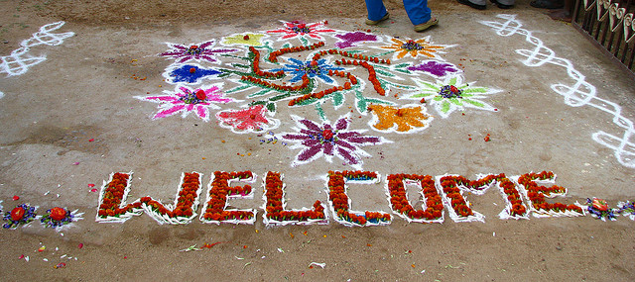
How is Title I funding used at South Woods?
Staff Materials Parent Involvement

Slide 5
Interventionist Team
K & 1 Jenny Moore-Jones
2 & 3 Amber Daniels
4 & 5 Margo Meyer
The role of the Interventionists here at South Woods Elementary is to support student achievement in the area of Reading/Math, with special attention to reading.

Slide 6
Schedules
8:35-8:55 Morning Meeting
8:55-10:25 ELA
10:25-11:05 Target
11:05-12:15 Math
12:15-1:05 Lunch/Recess
1:05-1:55 Science and Social Studies
1:55-2:30 Resource
2:30-2:45 Pack up
Specials Rotation
1:55-2:30 | Day A | Day B | Day C | Day D | Day E
Art | Keath | Peel | Strecker | Tanner & Meiselman | Wilcox
Physical Education | Wilcox | Keath | Peel | Strecker | Tanner & Meiselman
Music | Tanner & Meiselman | Wilcox | Keath | Peel | Strecker
Media | Strecker | Tanner & Meiselman | Wilcox | Keath | Peel
Computer Lab | Peel | Strecker | Tanner & Meiselman | Wilcox | Keath

Slide 7
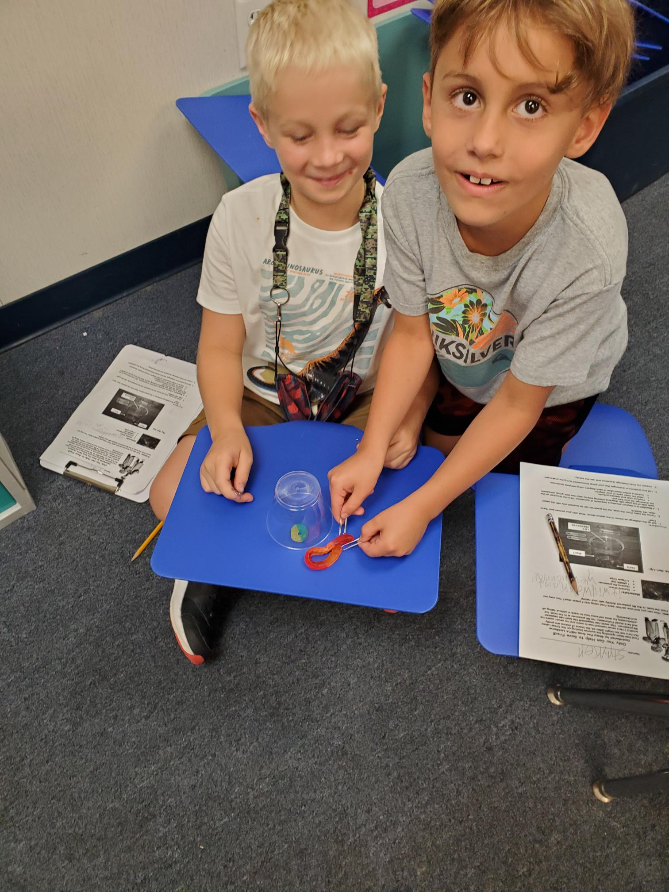
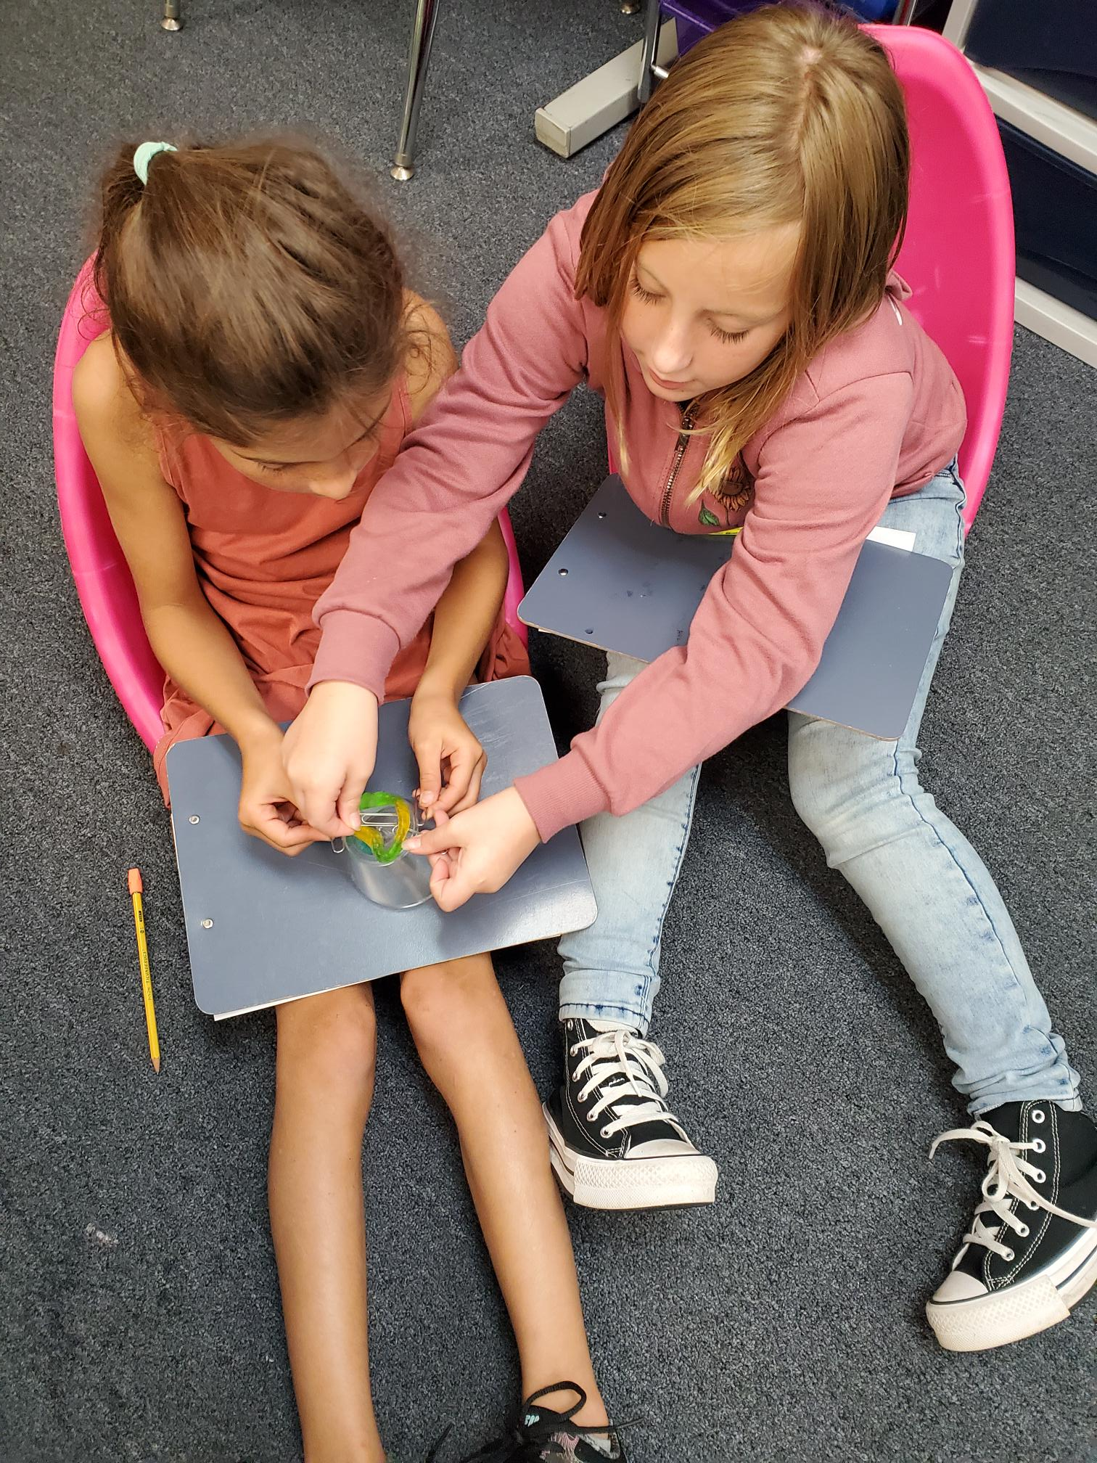
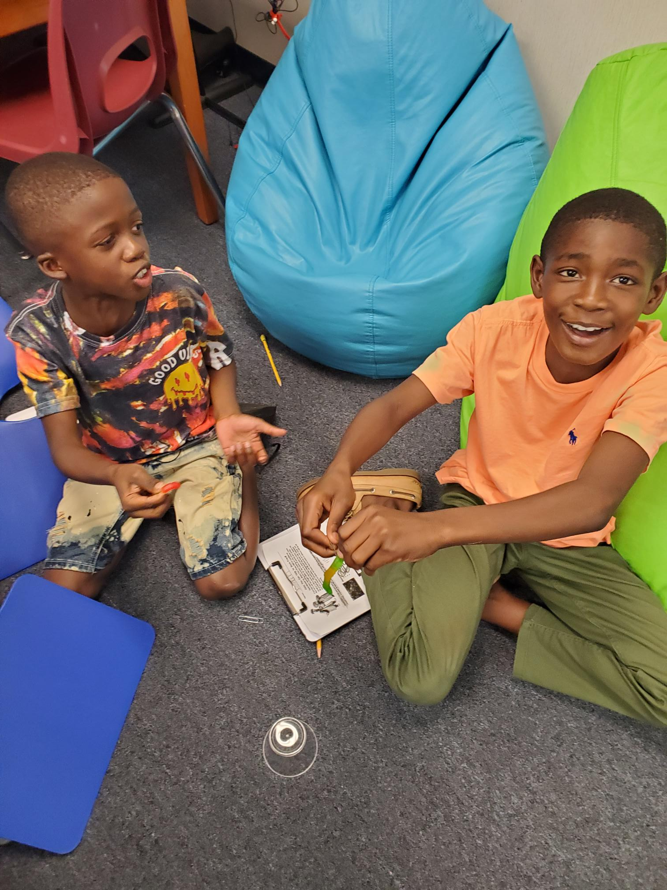
Reading and Writing
This year we are implementing the Florida B.E.S.T. Standards for ELA (English Language Arts). You can read more about the B.E.S.T standards here:
https://www.fldoe.org/core/fileparse.php/7539/urlt/Parent-Guide-Grade-3-Standards.pdf

Slide 8
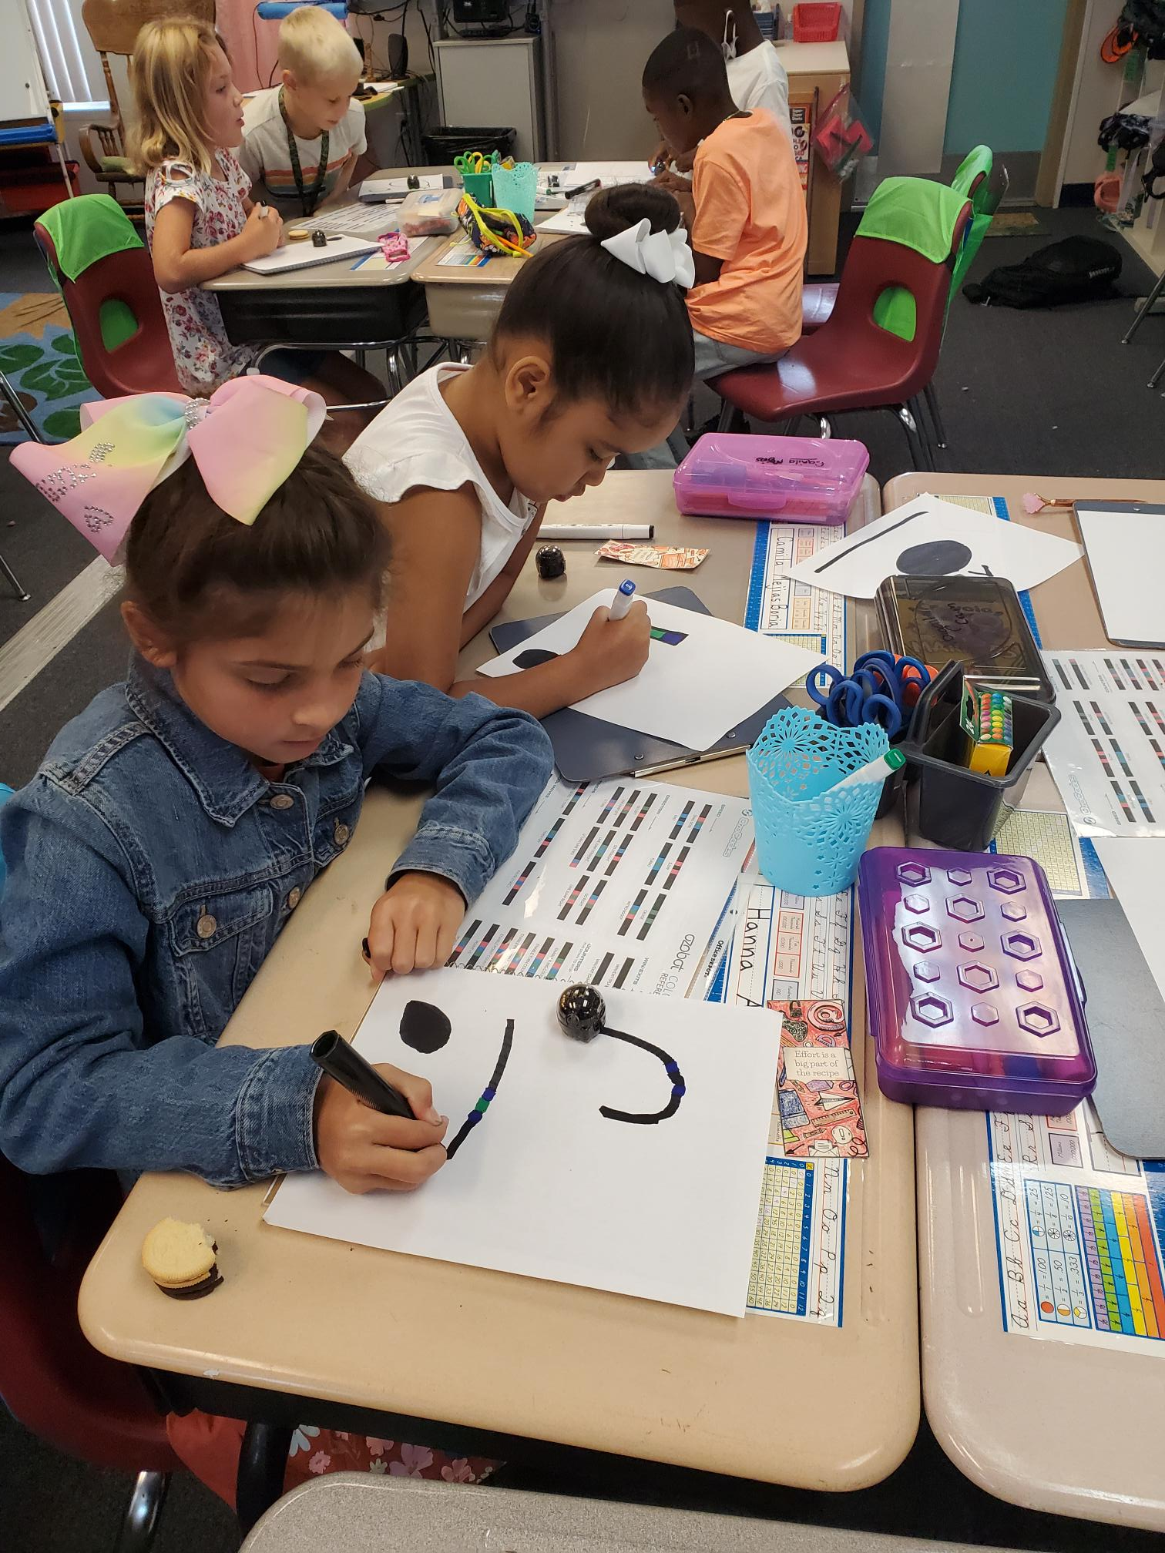
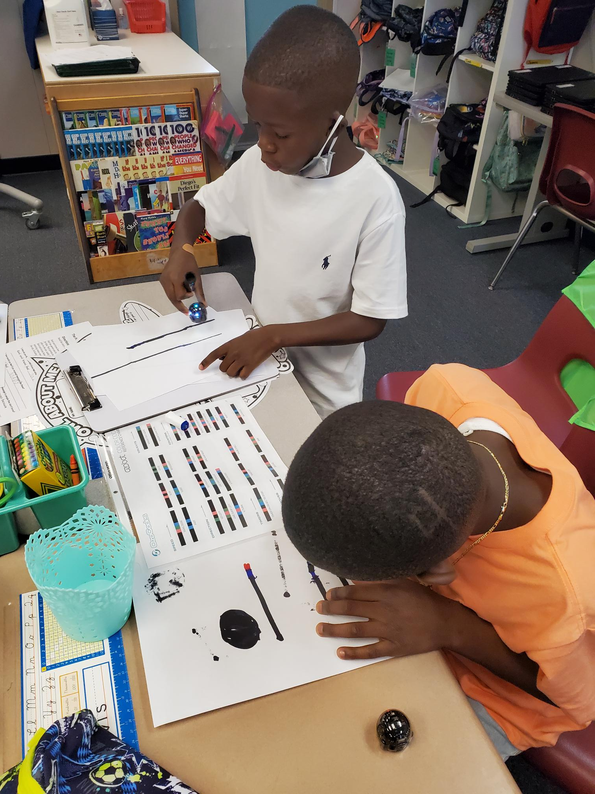
Math
Third grade’s main math focus is on multiplication and division. We will start by teaching students different strategies, and by January move into being more fluent with facts.
We are also focused on mastering 3-digit addition and subtraction, introducing fractions, area and perimeter.
https://www.fldoe.org/core/fileparse.php/12087/urlt/Fl_ParentGuide_Math_G3.pdf

Slide 9
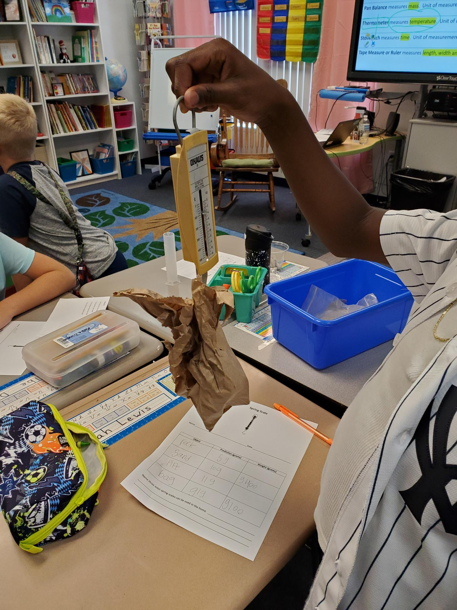
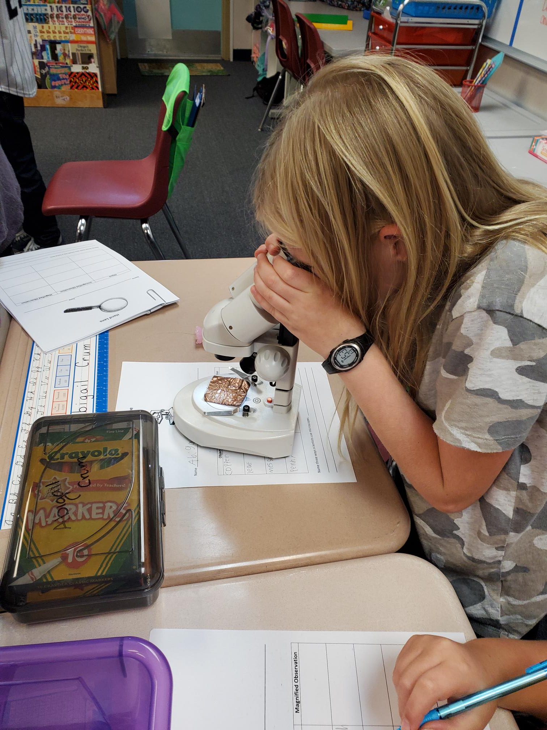
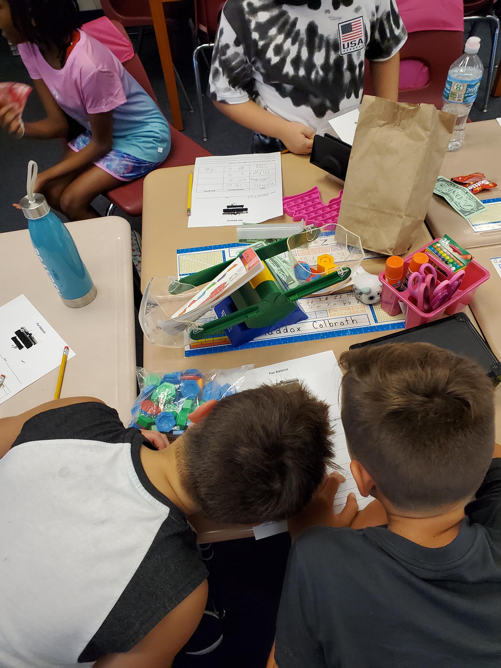
Science and Social Studies
Please view the Year-at-a-Glance documents to see what we will be learning in science and social studies.
2021-22 Public Year at a Glance- Social Studies-Grade 3.pdf
3 Science Public YAG 2021-22.pdf

Slide 10
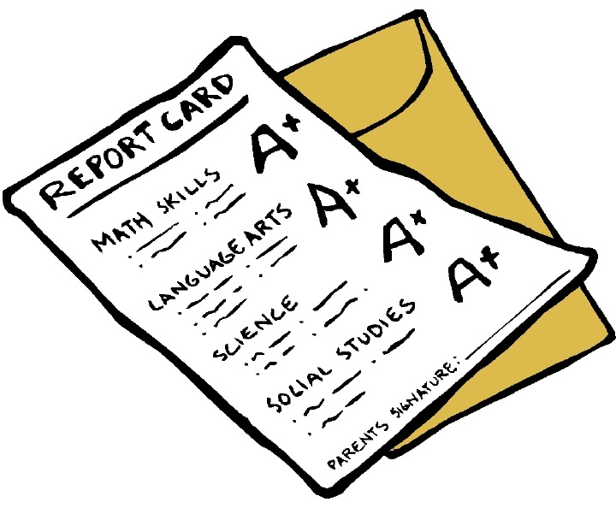
Grading
A 90-100
B 80-89
C 70-79
D 60-69
F Below 60
Students will earn letter grades this year. For some assessments, your child may have the chance to retake the assessment if they score below a 70%. This would happen after reteaching.
Please sign up for HAC and check your child’s grades weekly.

Slide 11
CHARACTER COUNTS! is an educational framework for teaching universal values and a national coalition of organizations that support each other. The result is a culture change in your school, business or organization. CHARACTER COUNTS! improves the lives of the adults who teach it, the communities that embrace it and the students who make better choices as a result of it
CHARACTER COUNTS!
All of the time. “The function of education is to teach one to think intensively and to think critically. Intelligence plus character – that is the goal of true education.” ~Martin Luther King, Jr.

Slide 12
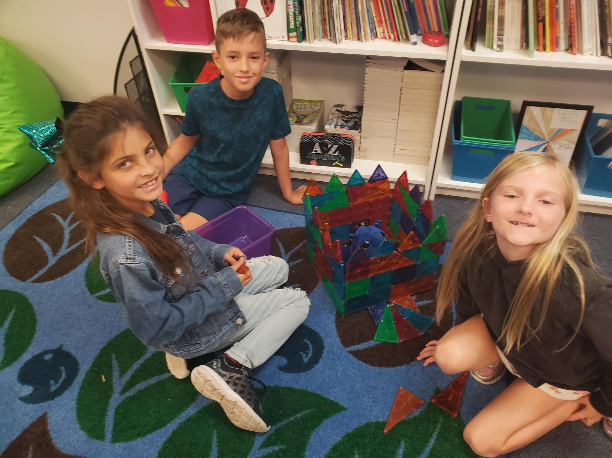
Behavior & Communication
South Woods is a PBIS school. This is a positive approach to improve school safety and promote positive behavior.

Slide 13
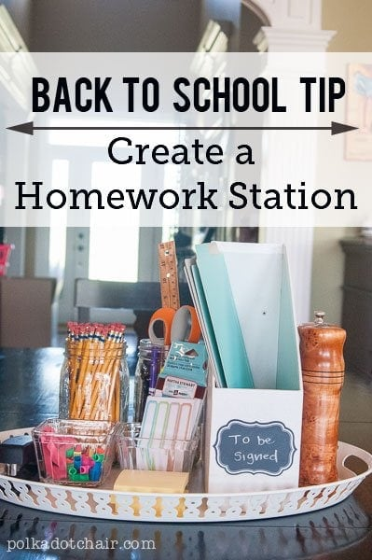
Homework
Please make sure your student reads for at least 20 minutes every night. In addition to reading, they may be assigned additional homework throughout the week. Homework should not take more than 30 minutes and should not be a source of frustration.

Slide 14
How Can Families Stay Involved?
Ask specific questions about school
Please honor school time and try to schedule important events accordingly
-Doctor’s appointments, family events, sports
Support with homework
Make school your child’s “job”
Celebrate short-and long-term goals

Slide 15
Conferences
Conferences will be scheduled October
19th-29th
These will be offered through phone calls
Your child’s teacher will contact you to set up your day and time

Slide 16
Closing
Thank you for viewing. Please contact your child’s teacher if you have any questions.

