Slide 1
Grade Level Curriculum Information
South Woods Elementary School
2021-2022

Slide 2
SWE Mission
South Woods Elementary School will create a positive learning environment that will instill good character and the desire for academic excellence, fostering the development of caring, productive, and digital citizens in the global world.

Slide 3
South Woods Information is a Title I School
What does it mean to be a Title I school?

Slide 4
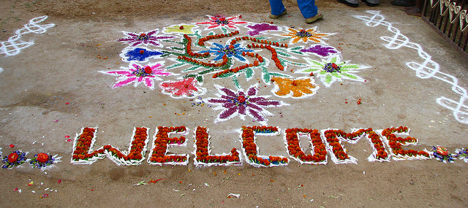
How is Title I funding used at South Woods?
Staff Materials Parent Involvement

Slide 5
Ms. Fillare’s Daily Schedule
8:00-8:35 Arrival/Breakfast
8:35-8:55 Morning Meeting
8:55-9:30 Specials
9:30-10:25 ELA Block (small group reading/iReady lessons)
10:25-10:45 Epic reading or TypingWeb practice
10:45-11:15 Recess/RR/break
11:15-11:45 Math Block (iReady lessons/small group math)
11:45-12:05 Lunch
12:05-12:35 Science/Social Studies
12:35-1:30 Small Groups/IEP Goals/ Cooperative Lessons
1:30-1:45 Teacher led Physical Exercise
1:45-2:00 Social Skills lesson
2:00-2:30 Review of Day, wrap up, prepare for dismissal

Slide 6
CHARACTER COUNTS! is an educational framework for teaching universal values and a national coalition of organizations that support each other. The result is a culture change in your school, business or organization. CHARACTER COUNTS! improves the lives of the adults who teach it, the communities that embrace it and the students who make better choices as a result of it
CHARACTER COUNTS!
All of the time. “The function of education is to teach one to think intensively and to think critically. Intelligence plus character – that is the goal of true education.” ~Martin Luther King, Jr.

Slide 7
Behavior & Communication
Daily Planners will be used to communicate with parents regarding daily participation, behavior, and overall performance. Tuesday folders will contain communications from school, please check for papers that need to be returned, and papers that can be kept at home.

Slide 8
How Can Families Stay Involved?
Ask specific questions about school
Please honor school time and try to schedule important events accordingly
-Doctor’s appointments, family events, sports
Support homework blocks
Make school your child’s “job”
Celebrate short-and long-term goals

Slide 9
Conferences
Conferences will be scheduled October 19th-29th
These will be offered through phone calls
Your child’s teacher will contact you to set up your day and time

Slide 10
Contact me at….
Thank you for viewing, contact your child’s teacher if you have any questions.
Feel free to contact me at tara.fillare@stjohns.k12.fl.us

