Slide 1
South Woods Elementary School
SWE School Information
September 24, 2024

Slide 2
South Woods is a Title I School
South Woods receives supplementary federal funds to enhance our educational program. These funds are intended to enrich and accelerate our learning environment. Additional support for our students includes:
• Three interventionists
• One STEM Lab Teacher
• Three Paraprofessionals
• One PE Paraprofessional

Slide 3
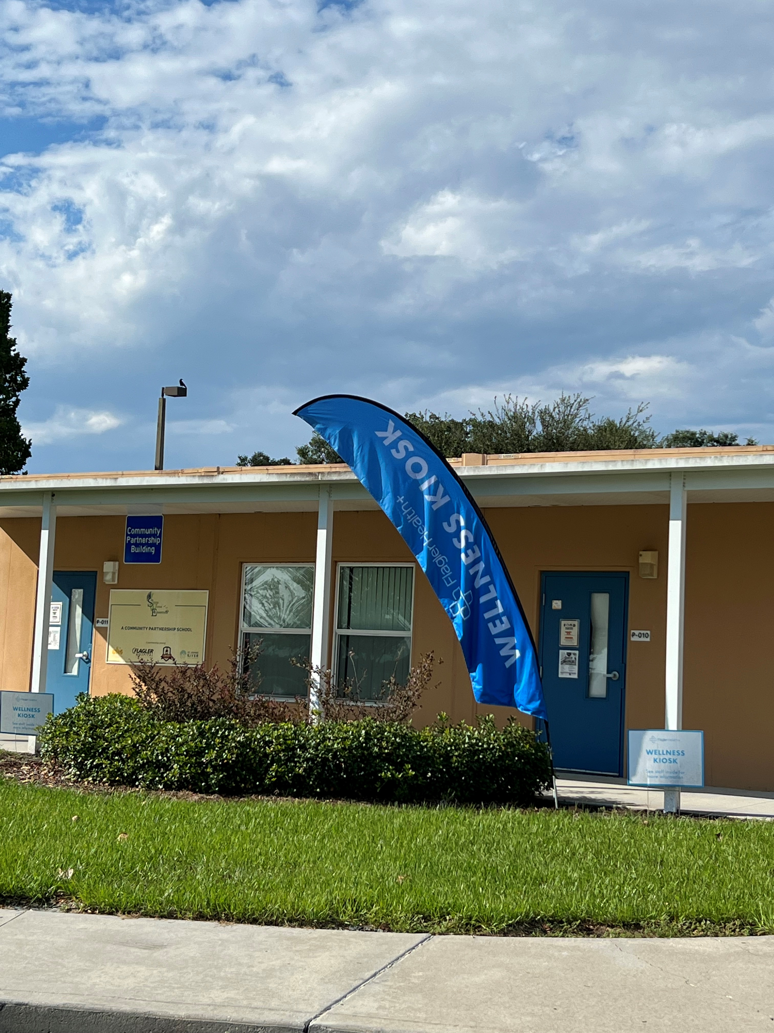
South Woods is a Community Partnership School
Community Partnership Schools provide support, services, and solutions to help alleviate burdens. As more weight is lifted, students find the balance to focus on learning so they can realize their full potential. Community Partnership Schools bring together high-quality academics, health care, counseling, support, mentoring, and more to a place where students and their families are empowered: in their school.

Slide 4
School Advisory Committee
Third Tuesday of the month 3:30pm Media Center
Parents and community members that provide input on the School Improvement Plan and make decisions regarding funds to best support annual goals.
If interested, contact Mrs. Angela Rodgers
Parent Teacher Organization
Third Tuesday of the month 4:15pm Media Center
Parents and teachers collaborating on ways to enhance the experience children have at school- Fall Festival, Winter Wonderland, Spring STEAM Night, and fundraisers.
If interested, contact Mrs. Lori Kosier

Slide 5
Safety Measures
Precautions
Keep n Track
Interior & Exterior Additions
Drills
Fire, Tornado, Lockdown, & Evacuation
Threats
Trained Team Investigates
See Something, Say Something
Taken Seriously
Monitor Exposure to Violent Content

Slide 6
South Woods Elementary School
K Curriculum
September 24, 2024

Slide 7
Measuring Students’ Success in KG
Mastery of the ELA and Math BEST Standards
The Year-At-A-Glance shows parents which standards will be taught during the school year and when
Checklists, along with summative and formative assessments measure progress throughout the year
Student’s progress is communicated on interims and report cards
Notes:
Get the QR code and add to this slide

Slide 8
Measuring Students’ Success in KG
Interim and Report Grades
M- Meeting the standard
P- Progressing towards the standards
I- Improvement Needed
STATE Tests (FAST Reading & Math)
PM1- August - September
PM2- December - January
PM3- May

Slide 9
Supporting Your Kindergartners’ Success
Support your student by practicing the following skills:
Name Writing (first and last)
Letter Writing
Number Writing
Identifying all upper- and lower-case letters
Identifying letter sounds (both consonants and vowels)
Counting to 100
Gross Motor Skills (standing and walking, running and jumping, and sitting upright at the table)
Fine Motor Skills (reaching, grasping, and manipulating objects with your hands)
Using scissors

Slide 10
Understanding Your Student’s STAR / FAST Scores
STAR Score Report | FAST Score (HAC & FDOE)
Time adjusted score that is determined by WHEN the student takes the test and compared to other students around the nation who are taking the same test at the same time. | Fixed (static) benchmark score that compares the student’s performance to the spring benchmark expectations REGARDLESS of WHEN the test is taken.
This score report shows student growth over a period of time AND provides information on TYPICAL growth for students in each achievement level at the time they took the test. | This report provides the END GOAL for students and shows how the student is progressing toward that goal with each progress monitoring session.
Any “state report” from Renaissance does not correlate to the FAST reporting. | This report is UNIQUE to Florida students.

Slide 11
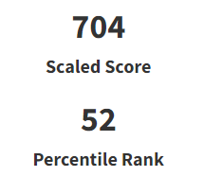
FAST Reading and Math Data: PM1 STAR Parent Report
Notes:
Explain to parents that if your student doesn’t have a score, it is because they did not pass the practice test. The practice test tells us if the student is ready to take the test. It asks a series of Math or Reading questions and questions that allow students to demonstrate if they can use the platform. Students who did not pass the practice test will have another opportunity during the 2nd Progress Monitoring Assessment.

Slide 12
FAST Reading and Math Data: PM1 STAR Parent Report
Scale Score
The Scaled Score is your child's overall score, calculated based on both the difficulty of the questions and the number of correct responses. Scaled Scores in Star Early Literacy in the Unified scale range from 200 to 1100 and span the grades Pre-K through 3.
Scaled Scores relate to four developmental stages.
Early Emergent Reader (200 - 682)
Late Emergent Reader (683 - 785)
Transitional Reader (786 - 851)
Probable Reader (852 - 1100)
Notes:
Allow parents time to pause and reread the letter to identify their student’s scale score and which developmental stage their student is in.

Slide 13
FAST Reading and Math Data: PM1 STAR Parent Report
Percentile Rank
Percentile Ranks (PR) is a norm-referenced score that indicates the percentage of other students nationally who obtained scores equal to or lower than your student’s score.
Our district and school’s goal is for students to be in the 50th percentile or higher, indicating they are at or above grade level.
Students receive a scale score and a percentile rank in both reading and math.
Notes:
Allow parents time to pause and reread the letter to identify their student’s percentile rank on the Early Literacy test. Take another moment to allow students to read the parent

Slide 14
FAST Reading and Math Data: PM1 STAR Family Report
The Math STAR Family report provides parents with the scale score, percentile rank, math intervention level, and strand scores.
There are four intervention levels:
Urgent Intervention
Intervention
On Watch
At or Above/Grade-Level
Our school and district’s goal is for students to perform at or above grade level in Reading and Math.
Notes:
Let parents know that students will not receive a STAR Family report for reading. However, during their upcoming parent-teacher conference, their student’s teacher can tell them their student’s reading intervention level. Allow parents time to pause and identify their student’s Math intervention level.

Slide 15
FAST Reading and Math Data: PM1 STAR Family Report
In addition to scale score, percentile rank, and intervention level, the Math Family report provides the student’s strand score for Math.
Strand scores range from 0-100 and represent each student’s estimated percent of mastery at a Kindergarten level.
Notes:
Point out to parents that students will get a strand score for five areas in Math (Measurement, Geometric Concepts, Counting and Cardinality, and Operations. Remind parents that during parent-teacher conferences, they can get additional information from their student’s teacher, such as which skills students can do and what skills they still need support with. Allow parents time to pause and identify their student’s strand scores.

Slide 16
Supporting Your Kindergarteners’ Success
Get a good night’s sleep (no naps)
Arrive at school on time every day
Communicate with your student’s teacher regularly
Encourage your student to try their best
Set the tone for a positive day each morning
Read with your students nightly
Complete activities on the Extra Practice Calendar for homework

Slide 17
Thanks for Attending!

